Slide 1
TX-APCD Advisory Group Meeting
March 25, 2026

Slide 2
Welcome and Agenda
Good afternoon, and welcome to the March 25, 2026, TX-APCD Advisory Group Meeting.
Please keep in mind, the statute for the Advisory Group requires us to be mindful of possible conflicts of interest.
A person serving on the stakeholder advisory group must disclose any conflict of interest. If you believe you have a conflict on an item being discussed, please just raise your hand and let us know.

Slide 3
Welcome and Agenda
Today, we’ll cover:
Application Framework: External Researchers and Data Access
Meeting the Challenge of Data Quality and Validation
National Engagement – Denied Claims

Slide 4


Application Framework - Purpose and Context
Stewardship with lawful access: Statutory + Policies
CHCD at UTHealth Houston administers the TX-APCD to enable use of claims data while meeting statutory, privacy, and security requirements (Texas Insurance Code, Ch. 38) and CHCD policy.
Staged review to reduce misfit: Intake + Full Application
Early informal consultation after initial intake review helps confirm feasibility, eligibility, and scope; formal steps then proceed through the full application review.
Who + why drives approval
External applicants must qualify as a Qualified Research Entity (QRE) and clearly support statutory public-interest purposes (e.g., transparency, quality improvement, cost containment, population health) under secure access controls.

Slide 5
Data Request Stages
As Easy As 1 – 2 – 3
01
Online Request Intake
Submit the intake form for CHCD-managed datasets (incl. TX-APCD). All CHCD datasets share the same starting point.
02
Intake Review
Staff follows up to clarify goals, constraints, and options. Researcher may require budget only or other limited feedback. Early screening for eligibility and feasibility. For TX-APCD, assesses potential QRE status and alignment with statutory purposes; may require scope refinement.
03
Full Application
Submit and complete the TX-APCD Application (IRB protocol/letter, data elements template, scope of work, and any QRE materials). CHCD simultaneously prepares a fee quotation.

Slide 6
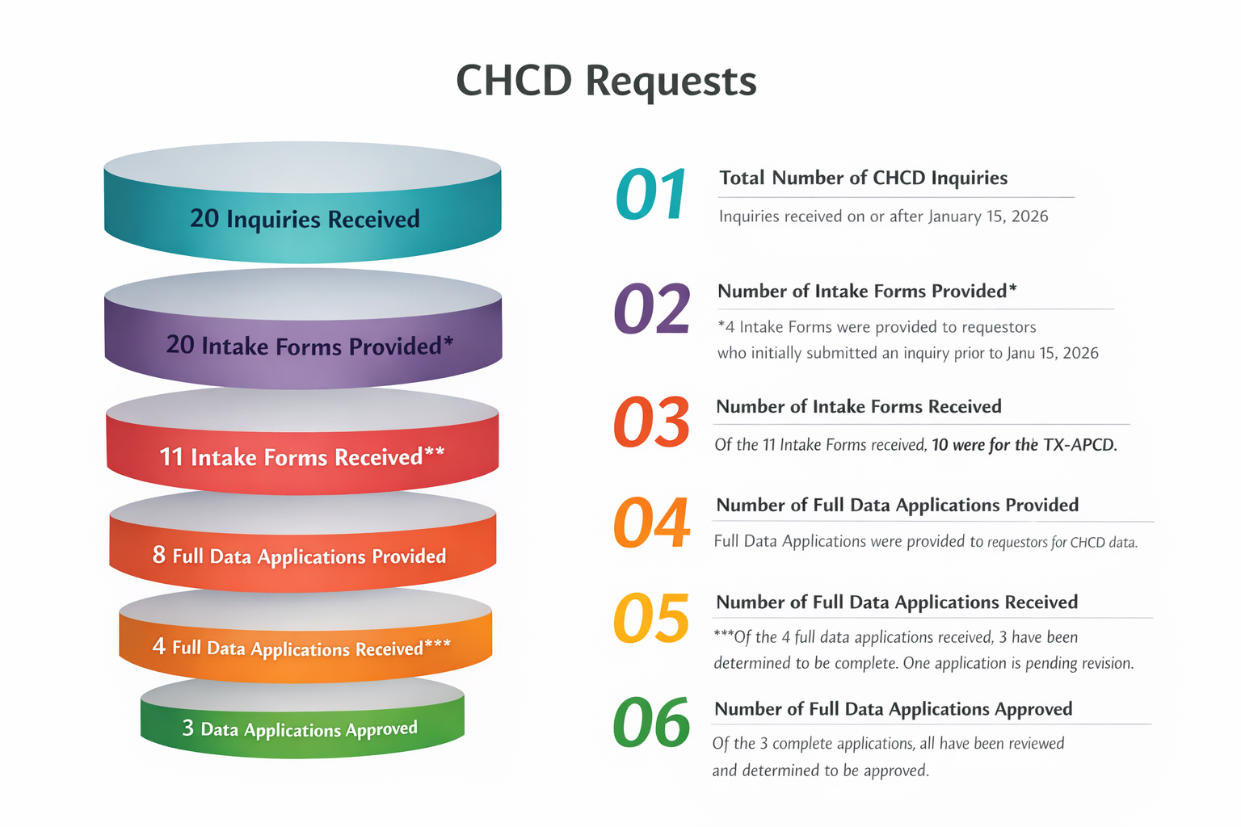
Data Request Status
Everyone who wants an application gets one.
Not all intake forms result in an immediate application. Ex. intake form was completed to request a budget for grant opportunities. A full application won’t be necessary until researcher obtains funding.
asdf
s

Slide 7
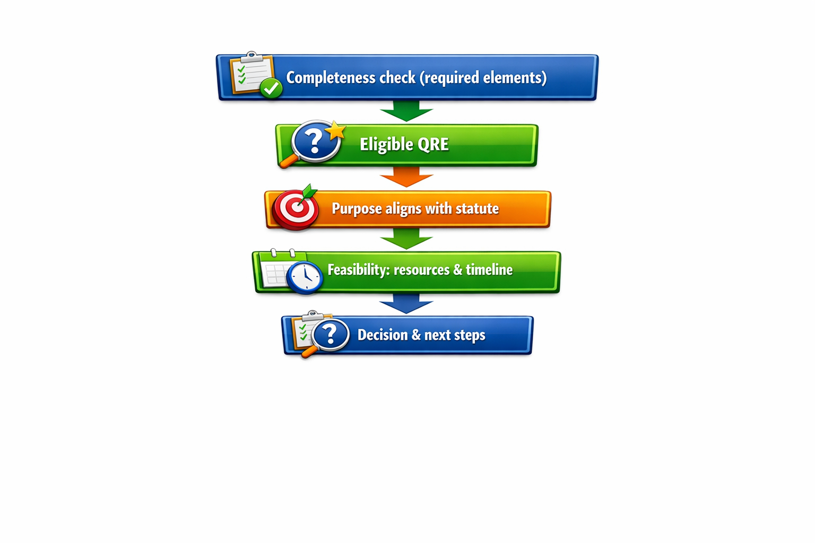
Completeness check
CHCD verifies required elements (funding, users, questions, methods, timeline, tools, IRB). Missing/unclear items trigger a request for information. Completed applications have 90-day goal for decision.
Eligibility/purpose review
Staff assesses feasibility (“all records”), CHCD resourcing, and reasonableness of timelines. In parallel, CHCD evaluates the documents/affirmation of QRE status and statutory purpose alignment.
Purpose of the Act
Increase public transparency of health care information in Texas;
Improve the quality of health care in Texas;
Improve the quality of care or reduce the cost of care. (HCP)
Decision and reconsideration
Approvals require team agreement. Denials are documented; Reconsideration permitted.

Slide 8
Data Provisioning Stages
As Easy As 1 – 2 – 3
01
QRE Agreement on Data Use
QRE must agree to use the data in accordance with standards, requirements, policies, and procedures of the TX-APCD. Ex. Security standards, agreement not to violate anti-trust laws, adhere to the CMS’ current cell size suppression policy, etc.
02
Pay a Fee
Before provisions begins a fee to support the software, hardware, extract development, licensing and storage for the project.
03
Provisioning Begins
Within the confines of the agreed budget, provisioning begins. Creation of the data extract, establishment of enclave/VM, issuance of necessary access credentials.

Slide 9
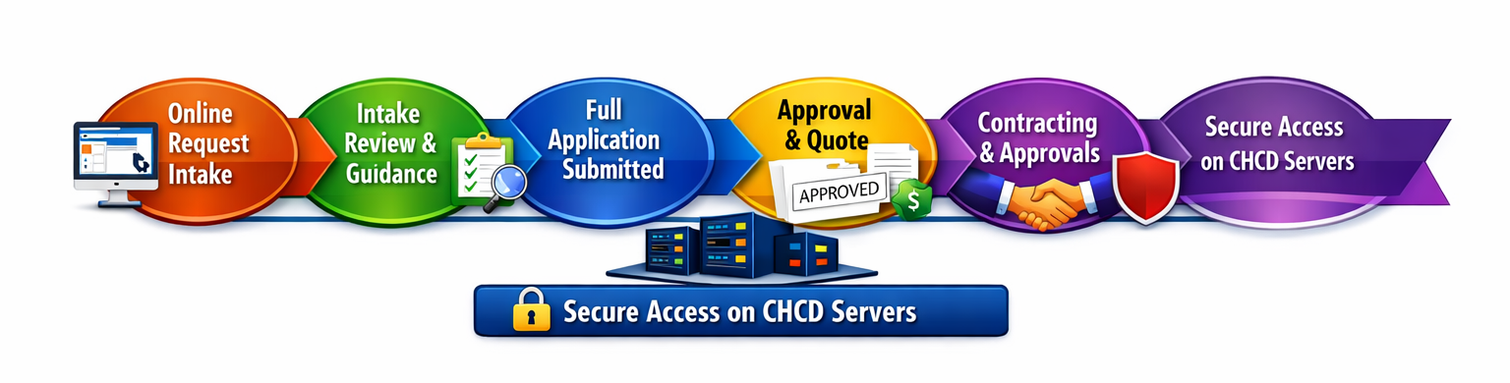
Full Process – Intake to Access

Slide 10
Meeting the Challenge of Data Quality and Validation
New Standing Agenda Item

Slide 11
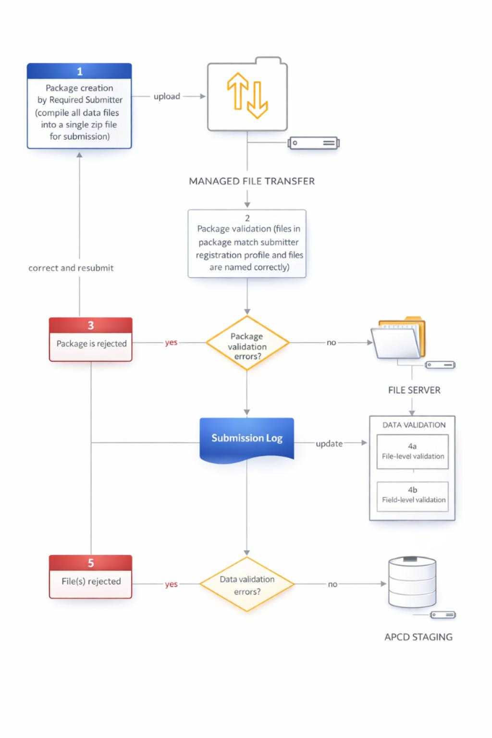
Data Validation

Slide 12
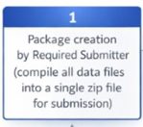
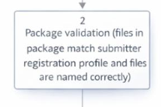
Managed File Transfer
MFT system verifies ZIP archive encryption.
Unencrypted files are destroyed.
Submitter receives notification to resubmit encrypted package.
No further processing occurs for unencrypted submissions.
System verifies encryption file package.
Checks file profile matches submitter type.
Ensures all required files are present.
Validates file naming conventions.

Slide 13
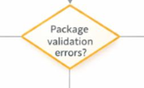

Package Validation Failure
If errors exist → proceed to Box 3.
If no errors → proceed to data validation.
Submission rejected if validation fails.
Submitter receives deficiency notice.
Notice includes error type and correction requirements.
Submitter must correct and resubmit encrypted package in 14 days or request an extension.

Slide 14
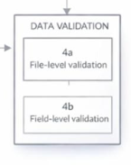
File and Field Level Validation
4a. Checks naming conventions.
Verifies reporting month and submitter identity.
Confirms file structure meets TX APCD standards.
Ensures required columns are present.
4b. Ensures presence of required data fields.
Validates data types (char, numeric, integer, decimal).
Checks formats: ZIP code, dates (YYYY-MM-DD), standard code sets.
System updates Submission Log with results.

Slide 15


Data Validation Errors?
If validation errors exist → proceed to Box 5.
If no errors → move to APCD Staging.
Files with validation errors are rejected.
Submitter receives detailed error report.
Report identifies file, row, field, and error type.
Submitter must correct and resubmit new encrypted package.

Slide 16
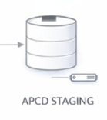
APCD Staging
Files passing all validation steps enter APCD Staging.
Submitter receives detailed report.
Staged files support standardization and normalization.
Additional Quality Review
Files become available for aggregation and analytic loading.

Slide 17
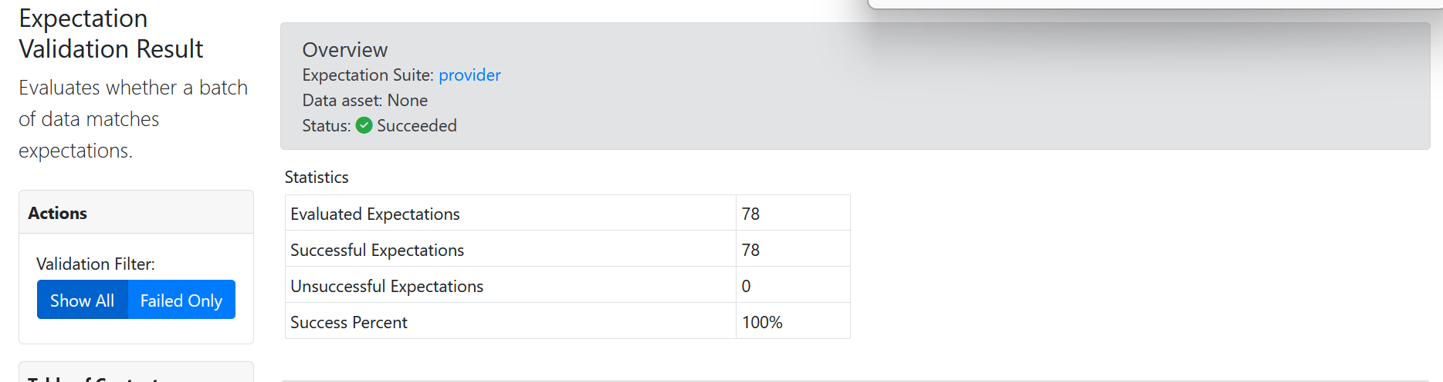
Automatic Report to Submitter
Validation Reports – Automatically Created and Sent
HTML report that reveals overall validation result.

Slide 18
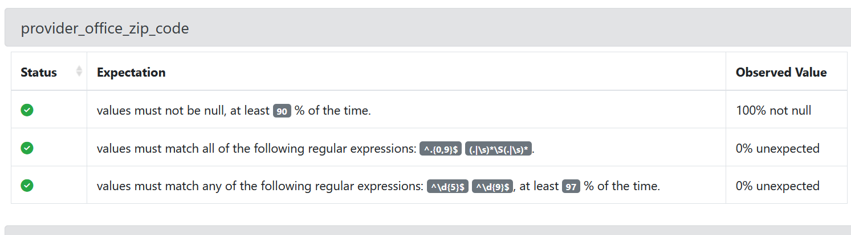
Automatic Report to Submitter- Pt 2
Validation Reports – Automatically Created and Sent
HTML report also provides a field level result.
If this field had failed – the status would be red along with the percentage of lines that contained unexpected results.

Slide 19
Substantive Data Review
Example - Missing Members
We are discovering a difference in the Member Eligibility File and actual members in claims for whom services are covered/paid.
More members get claims paid versus those who appear in claims
Payors explain that “retroactive terminations” are an explanation.
When the claim is first adjudicated the member is considered covered
Only later, the payor is informed that the member has left the group.
Or, eligible members who have no medical claims are not recorded in the eligibility files (silent members)
Another explanation is that members who were Texas residents are no longer living in Texas.
Submitter Forum – Bi-Monthly interaction with payors.

Slide 20
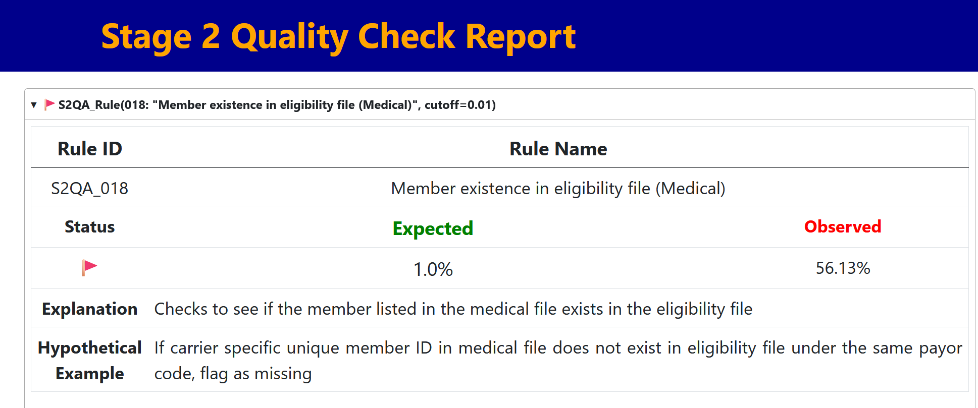
Substantive Data Review
However – even with substantive data review – we are moving toward automation:

Slide 21
National Engagement
Denied claims

Slide 22
Denied Claims
Peer states are seeking our insight. Two state APCDs recently contacted Texas to understand how the TX‑APCD collects and classifies denied claims, reflecting growing interest in our practical implementation choices.
Only denied claims with a CARC on the TX‑APCD’s approved list must be reported. If a denial uses a CARC not on the list, the payor does not need to submit that claim.
CARC 16 – Claim/service lacks information or has errors.
CARC 17 – Requested information not provided or insufficient.
CARC 18 – Duplicate claim/service.
CARC 19 – Claim denied because adjusted claim was already processed.
Denied claims have value as the services were performed
Because Texas has a clear CARC‑based framework for capturing denied claims, other states are looking to our structure and rules as they develop their own approaches.

